Slide 1
Unified Process Model

Slide 2
The Unified Process (UP) is a software development framework used for object-oriented modeling. The framework is also known as Rational Unified Process (RUP) and the Open Unified Process (Open UP). Some of the key features of this process include:
It defines the order of phases.
It is component-based, meaning a software system is built as a set of software components. There must be well-defined interfaces between the components for smooth communication.
It follows an iterative, incremental, architecture-centric, and use-case driven approach

Slide 3
Let's have a look at these approaches in detail.
The case-driven approach
Use a case-driven approach that follows a set of actions performed by one or more entities. A use case refers to the process of the team performing the development work from the functional requirements. The functional requirements are made from the list of requirements that were specified by the client. For example, an online learning management system can be specified in terms of use cases such as "add a course," "delete a course," "pay fees," and so on.
The architecture-centric approach
The architecture-centric approach defines the form of the system and how it should be structured to provide a specific functionality whereas the use case defines the functionality.

Slide 4
The iterative and incremental approach
An iterative and incremental approach means that the product will be developed in multiple phases. During these phases, the developers evaluate and test.
Phases
We can represent a unified process model as a series of cycles. Each cycle ends with the release of a new system version for the customers. We have four phases in every cycle:
Inception
Elaboration
Construction
Transition

Slide 5
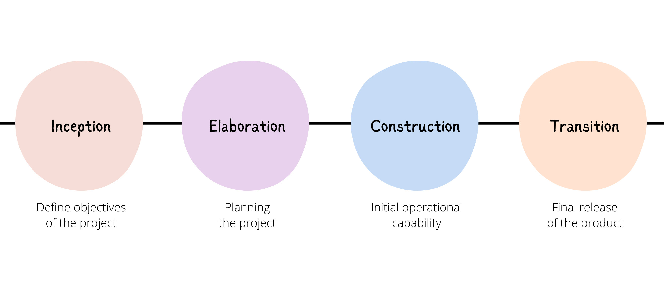

Slide 6
Benefits of Iterative Development
It includes:
early rather than late mitigation of high risks (technical, requirements, objectives, usability, and so forth)
early visible progress
early feedback, user engagement, and adaptation, leading to a refined system that more closely meets the real needs of the stakeholders
managed complexity; the team is not overwhelmed by "analysis paralysis" or very long and complex steps
the learning within an iteration can be methodically used to improve the development process itself, iteration by iteration
Time-boxed
A key idea is that iterations are time boxed, or fixed in length.
For example, if the next iteration is chosen to be four weeks long, then the partial system should be integrated, tested, and stabilized by the scheduled date—date slippage is discouraged.
If it seems that it will be difficult to meet the deadline, the recommended response is to remove tasks or requirements from the iteration, and include them in a future iteration, rather than slip the completion date.

Slide 7
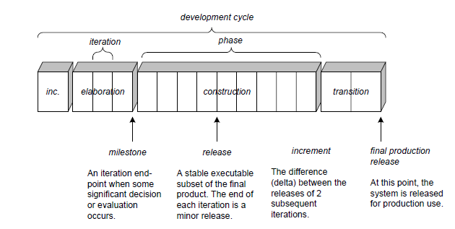
Schedule-oriented terms in the UP.

Slide 8
Coding
The coding is the process of transforming the design of a system into a computer language format. This coding phase of software development is concerned with software translating design specification into the source code. It is necessary to write source code & internal documentation so that conformance of the code to its specification can be easily verified.
Coding is done by the coder or programmers who are independent people than the designer. The goal is not to reduce the effort and cost of the coding phase, but to cut to the cost of a later stage. The cost of testing and maintenance can be significantly reduced with efficient coding.

Slide 9
Goals of Coding:
To translate the design of system into a computer language format: The coding is the process of transforming the design of a system into a computer language format, which can be executed by a computer and that perform tasks as specified by the design of operation during the design phase.
To reduce the cost of later phases: The cost of testing and maintenance can be significantly reduced with efficient coding.
Making the program more readable: Program should be easy to read and understand. It increases code understanding having readability and understandability as a clear objective of the coding activity can itself help in producing more maintainable software.

Slide 10
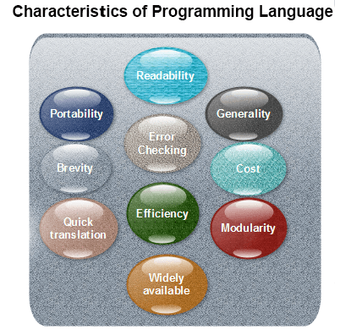
Characteristics of Programming Language:
Notes:
Readability: A good high-level language will allow programs to be written in some methods that resemble a quite-English description of the underlying functions. The coding may be done in an essentially self-documenting way.
Portability: High-level languages, being virtually machine-independent, should be easy to develop portable software.
Generality: Most high-level languages allow the writing of a vast collection of programs, thus relieving the programmer of the need to develop into an expert in many diverse languages.
Brevity: Language should have the ability to implement the algorithm with less amount of code. Programs mean in high-level languages are often significantly shorter than their low-level equivalents.
Error checking: A programmer is likely to make many errors in the development of a computer program. Many high-level languages invoke a lot of bugs checking both at compile-time and run-time.
Cost: The ultimate cost of a programming language is a task of many of its characteristics.
Quick translation: It should permit quick translation.
Efficiency: It should authorize the creation of an efficient object code.
Modularity: It is desirable that programs can be developed in the language as several separately compiled modules, with the appropriate structure for ensuring self-consistency among these modules.
Widely available: Language should be widely available, and it should be feasible to provide translators for all the major machines and all the primary operating systems.

Slide 11
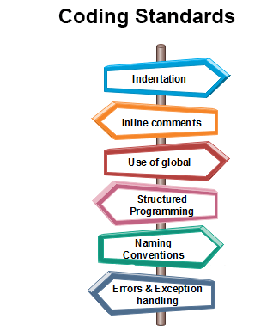
Coding Standards
General coding standards refers to how the developer writes code, so here we will discuss some essential standards regardless of the programming language being used.
The following are some representative coding standards:
Notes:
Indentation: Proper and consistent indentation is essential in producing easy to read and maintainable programs. Indentation should be used to:
Emphasize the body of a control structure such as a loop or a select statement.
Emphasize the body of a conditional statement
Emphasize a new scope block
Inline comments: Inline comments analyze the functioning of the subroutine, or key aspects of the algorithm shall be frequently used.
Rules for limiting the use of global: These rules file what types of data can be declared global and what cannot.
Structured Programming: Structured (or Modular) Programming methods shall be used. "GOTO" statements shall not be used as they lead to "spaghetti" code, which is hard to read and maintain, except as outlined line in the FORTRAN Standards and Guidelines.
Naming conventions for global variables, local variables, and constant identifiers: A possible naming convention can be that global variable names always begin with a capital letter, local variable names are made of small letters, and constant names are always capital letters.
Error return conventions and exception handling system: Different functions in a program report the way error conditions are handled should be standard within an organization. For example, different tasks while encountering an error condition should either return a 0 or 1 consistently.

Slide 12
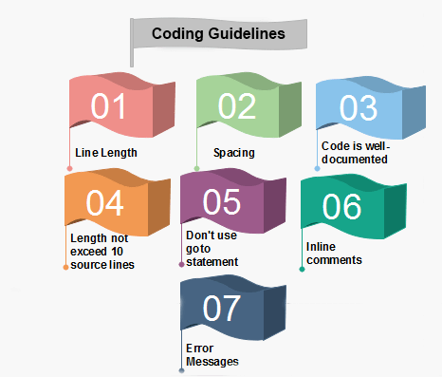
Coding Guidelines
Notes:
1. Line Length: It is considered a good practice to keep the length of source code lines at or below 80 characters. Lines longer than this may not be visible properly on some terminals and tools. Some printers will truncate lines longer than 80 columns. 2. Spacing: The appropriate use of spaces within a line of code can improve readability.
Example:
Bad: cost=price+(price*sales_tax) fprintf(stdout ,"The total cost is %5.2f\n",cost);
Better: cost = price + ( price * sales_tax ) fprintf (stdout,"The total cost is %5.2f\n",cost);
3. The code should be well-documented: As a rule of thumb, there must be at least one comment line on the average for every three-source line.
4. The length of any function should not exceed 10 source lines: A very lengthy function is generally very difficult to understand as it possibly carries out many various functions. For the same reason, lengthy functions are possible to have a disproportionately larger number of bugs.
5. Do not use goto statements: Use of goto statements makes a program unstructured and very tough to understand.
6. Inline Comments: Inline comments promote readability.
7. Error Messages: Error handling is an essential aspect of computer programming. This does not only include adding the necessary logic to test for and handle errors but also involves making error messages meaningful.

Slide 13
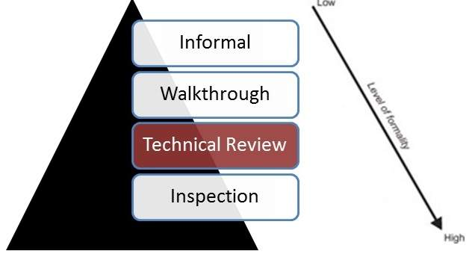
Code Review

